Slide 1
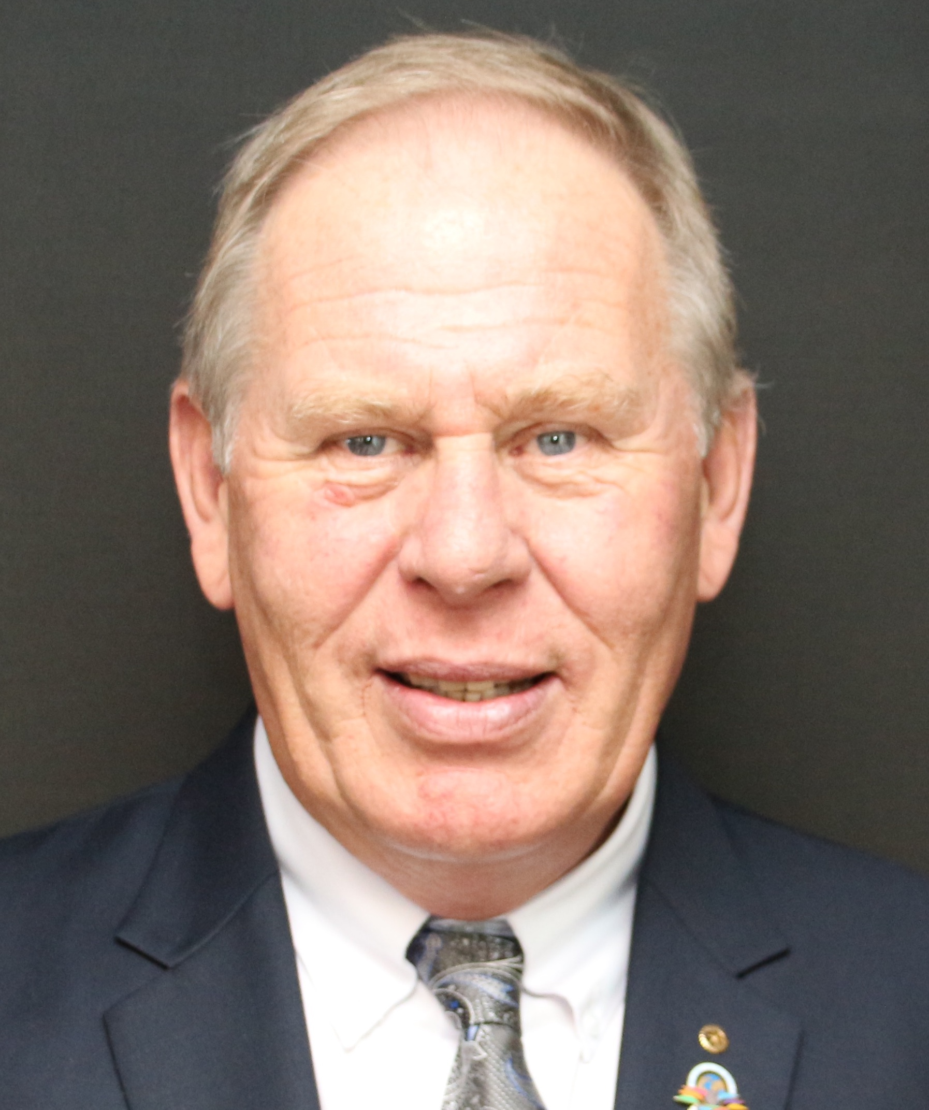
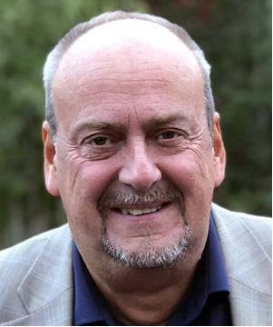
WELCOME TO MEMBERSHIP & RPIC TRAINING SEMINAR
RC Bjørn Aas Rotary Coordinator Overall support, Zone 18 +Supporting Norway & Iceland +”Online Tools!
RPIC Tore Jørgen Slettahjell Rotary Public Image Coordinator Supporting Zone 18 (except D2360 & D2390)

Slide 2
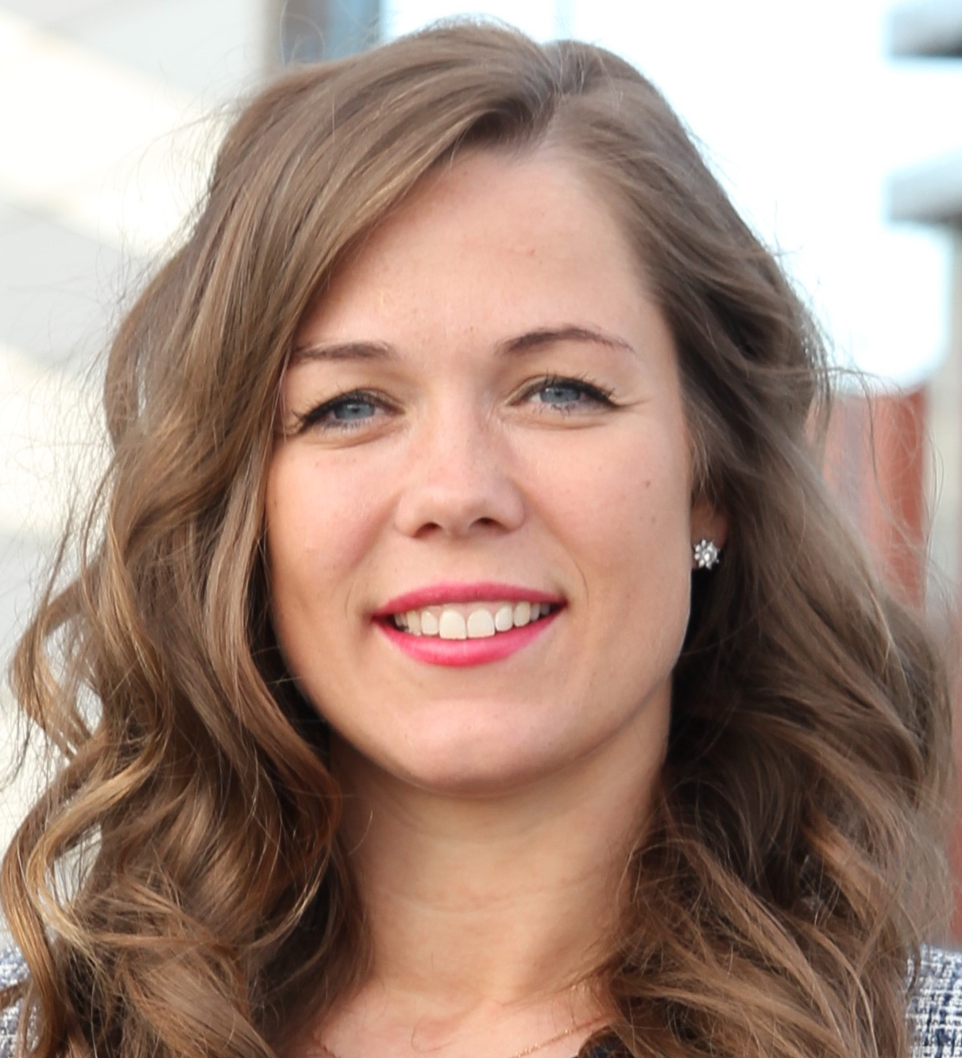
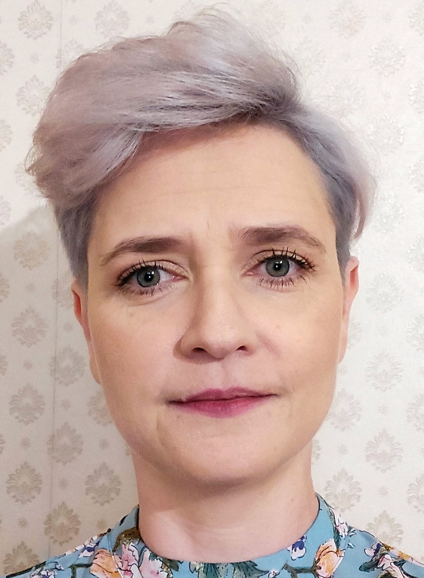
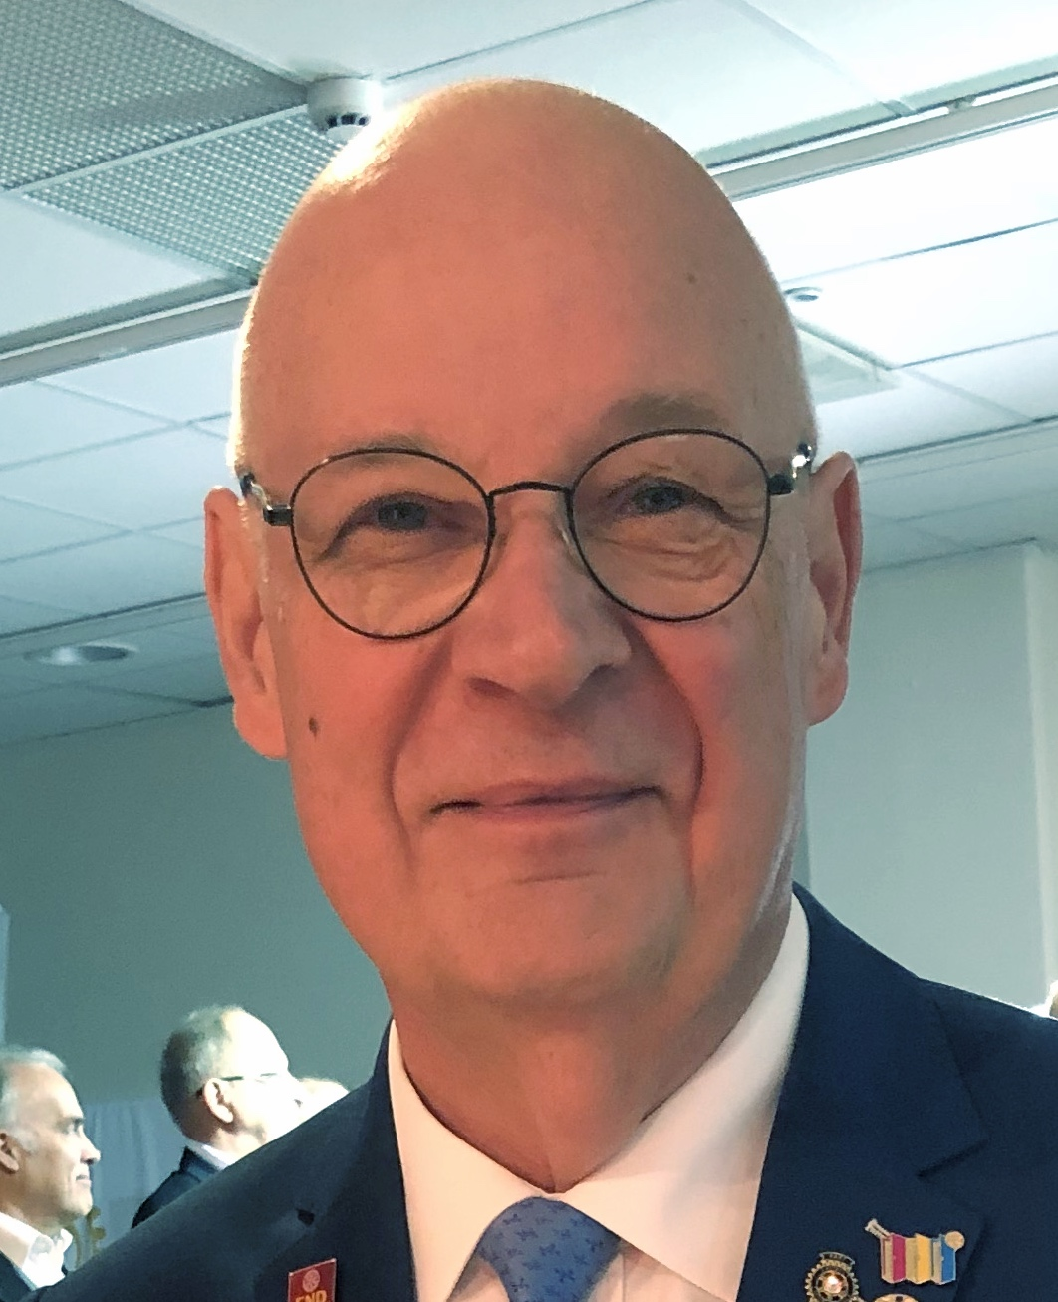
ROTARY COORDINATORS TEAM ZONE 18
RC Bjørn Aas Rotary Coordinator Overall support, Zone 18 +Supporting Norway & Iceland +”Online Tools!
ARC Mingaile Subaciute Assistant Rotary Coordinator Supporting: Lithuania +“Startup New Clubs”
ARC Angelika Przezdziek Assistant Rotary Coordinator Supporting Poland
ARC Torkil Rønne Assistant Rotary Coordinator Supporting Denmark +D2360 & D2390

Slide 3
ROTARY INTERNATIONAL Zones 17 & 18
Stavern satellite club young district 2290
RID Virpi Honkala Rotary International Director
virpi.honkala@fimnet.fi
Truls Løwer-Arnesen Leader Stavern Satellite Club Young
truls.arnesen@gmail.com

Slide 4
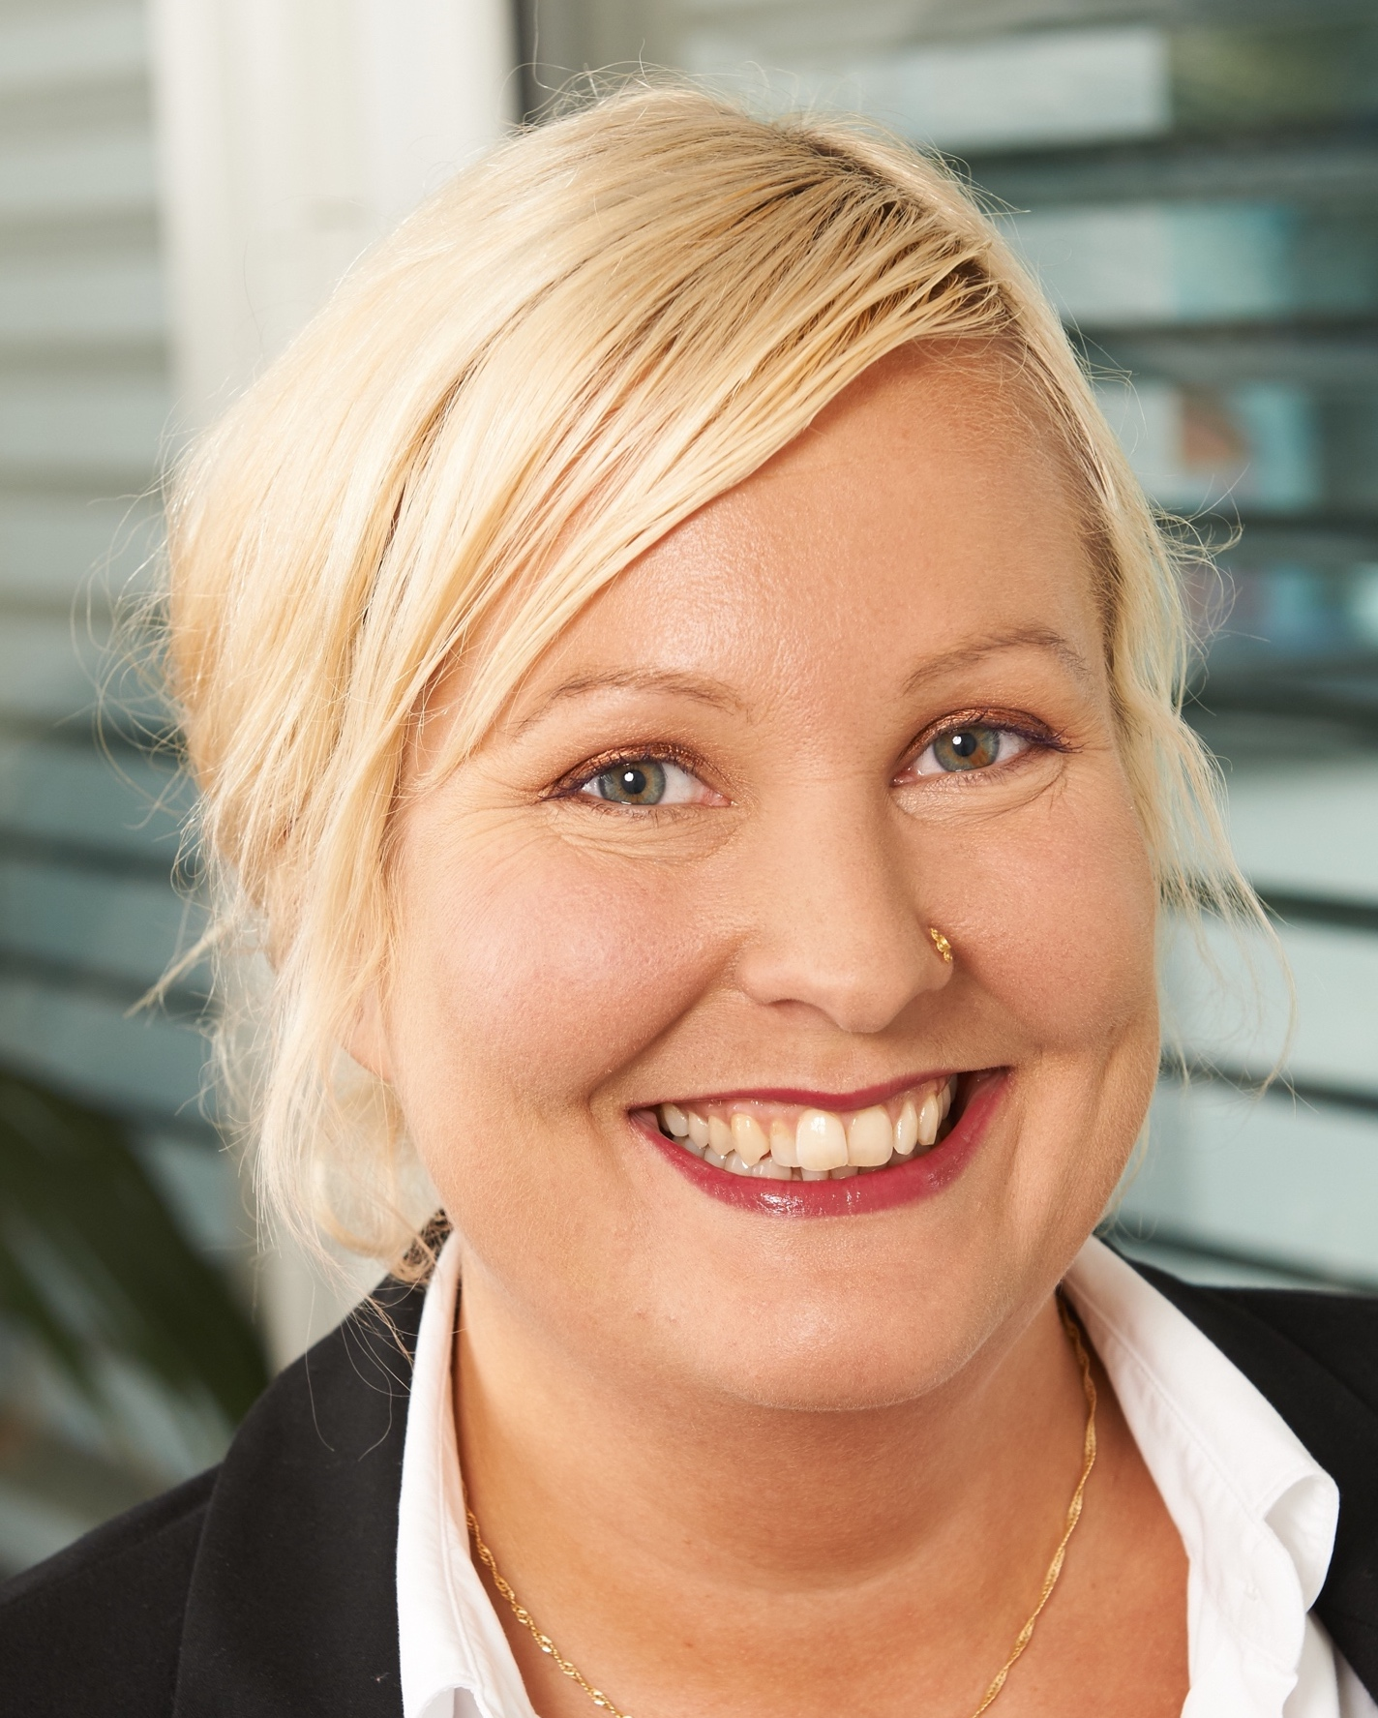
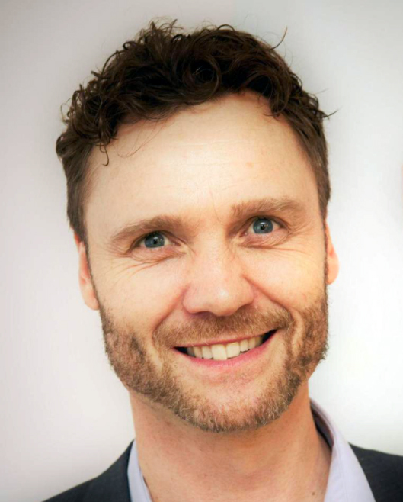
ROTARY INTERNATIONAL Europe / Africa office
Sari Miettinen Specialist
Sari.Miettinen@rotary.org
Nordic and Baltic Countries Club & District Support
Rasmus Egeskjold Rotary Membership Officer
rasmus.egeskjold@rotary.org
Nordic countries, Poland, The Russian Federation, Baltic counties and the Netherlands
ROTARY INTERNATIONAL | Europe/Africa Office | Witikonerstrasse 15 | 8032 Zurich | Switzerland

