Slide 1


Rotarys utdanningsprogram for ungdomsledere

Slide 2


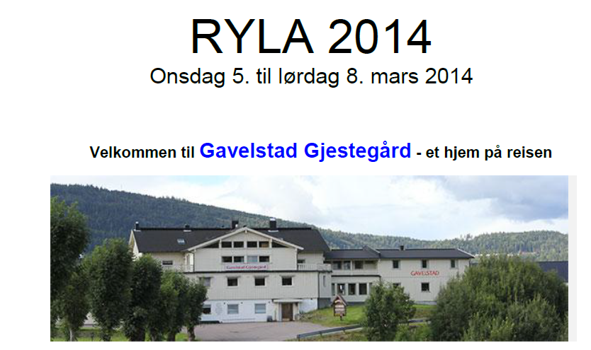
ÅRETS ARRANGEMENT

Slide 3
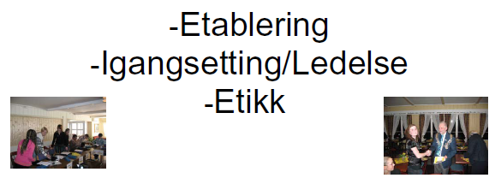
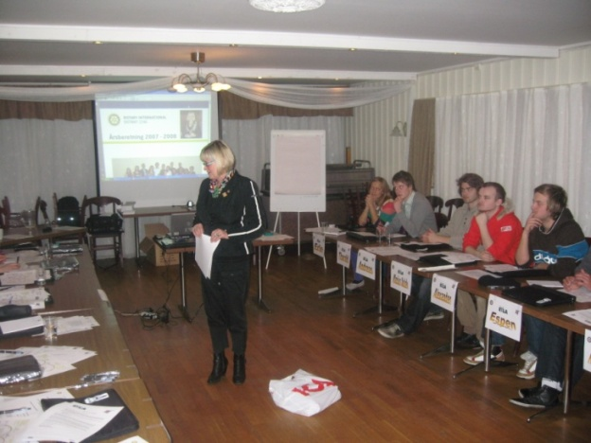
ÅRETS TEMA

Slide 4
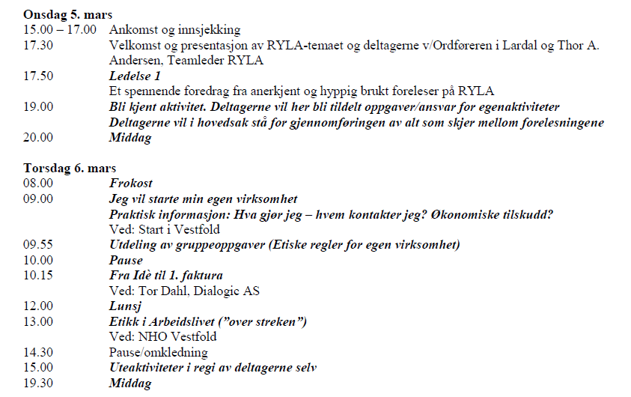
RYLA 2014 I DISTRIKT 2290

Slide 5
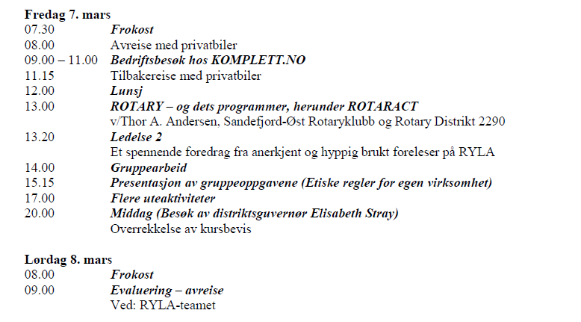
RYLA 2014 I DISTRIKT 2290

Slide 6
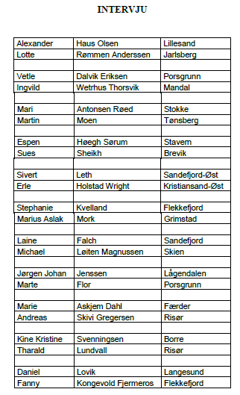
VERKTØY

Slide 7
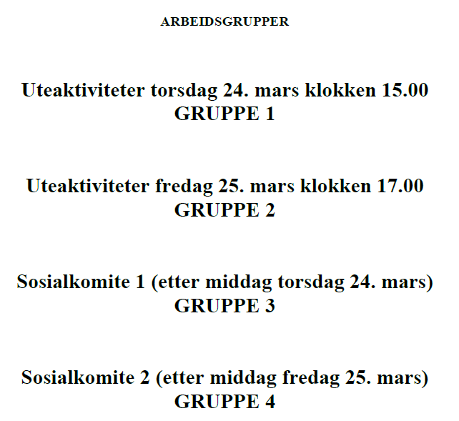
VERKTØY

Slide 8

EGET SANGHEFTE

Slide 9
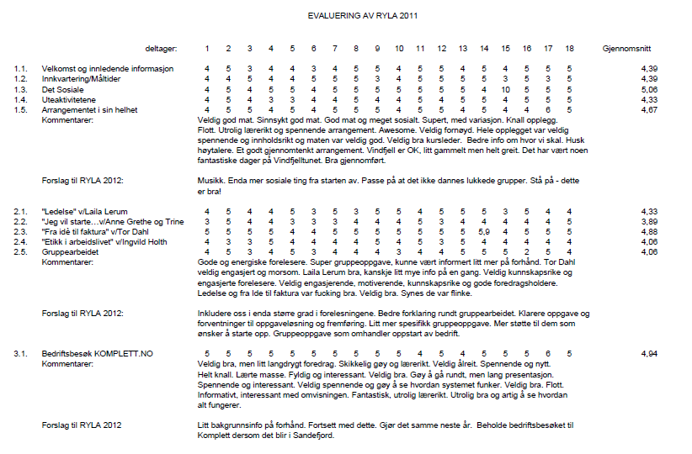
EVALUERING 2011

Slide 10

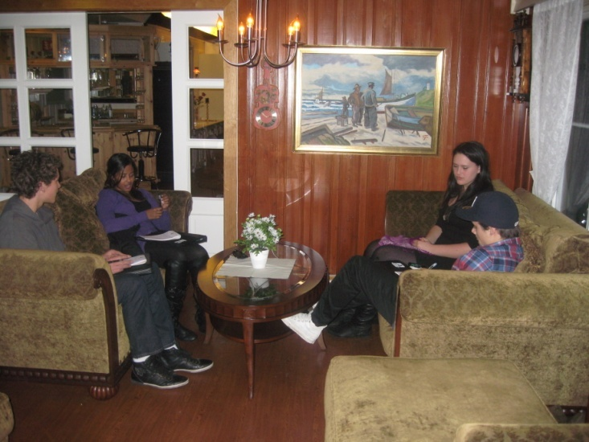
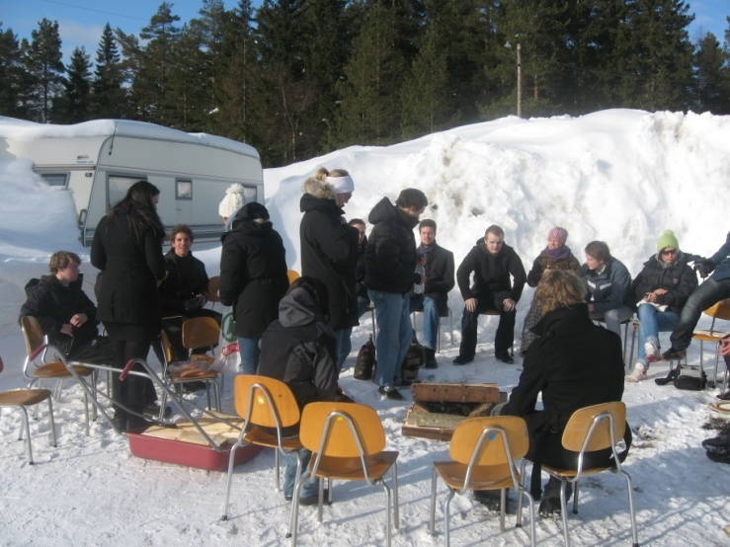
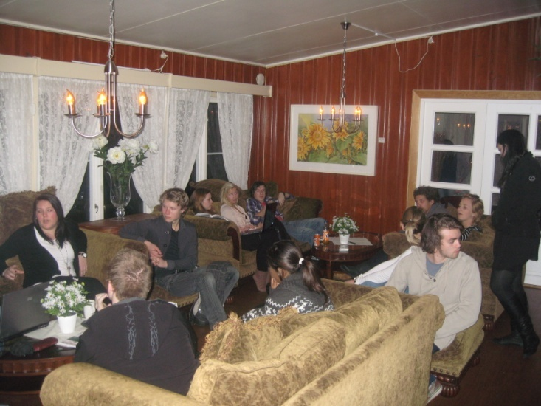
RYLA 2010

Slide 11
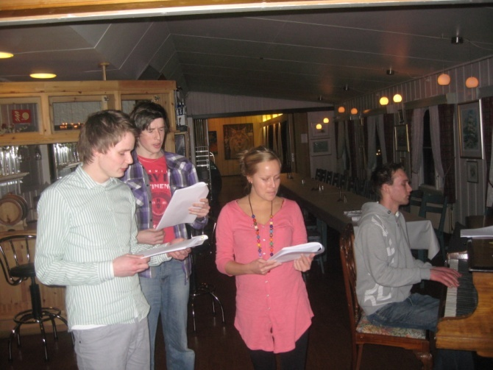
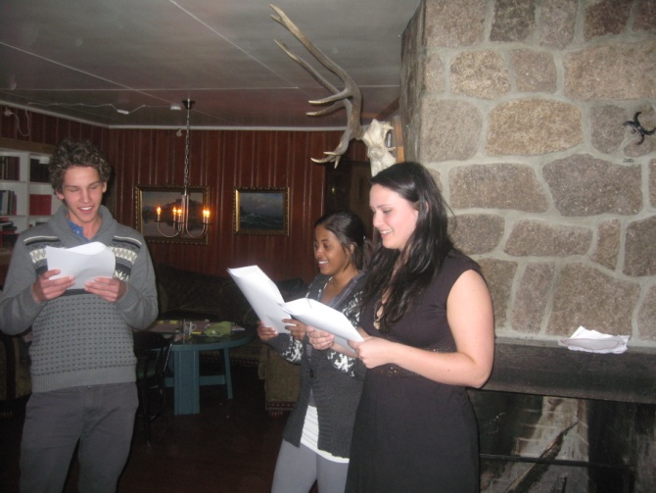
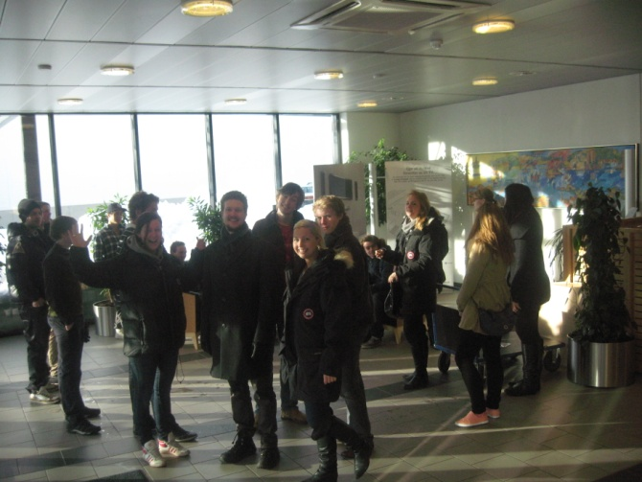
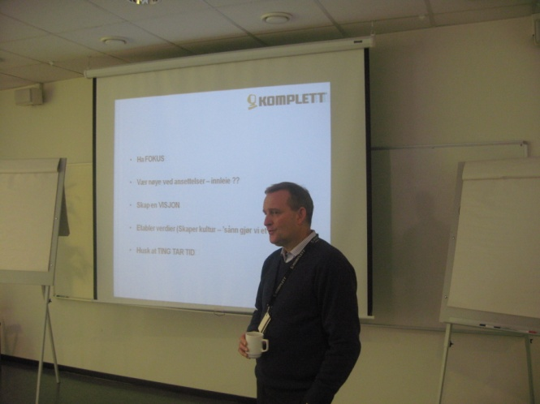
RYLA 2010

Slide 12
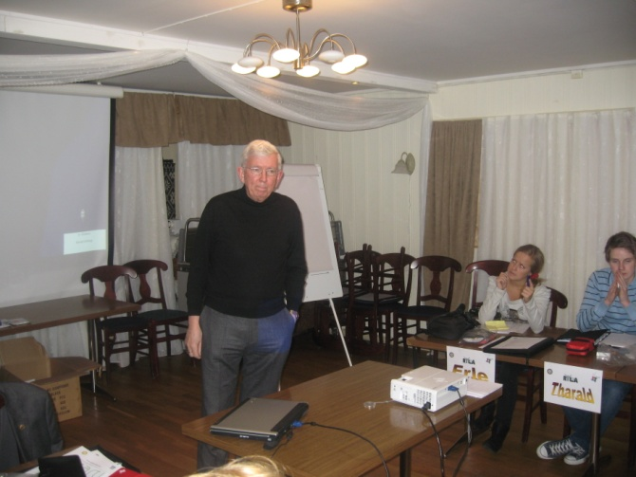
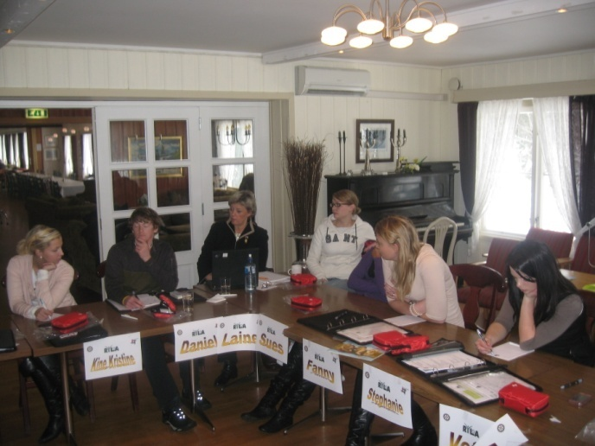
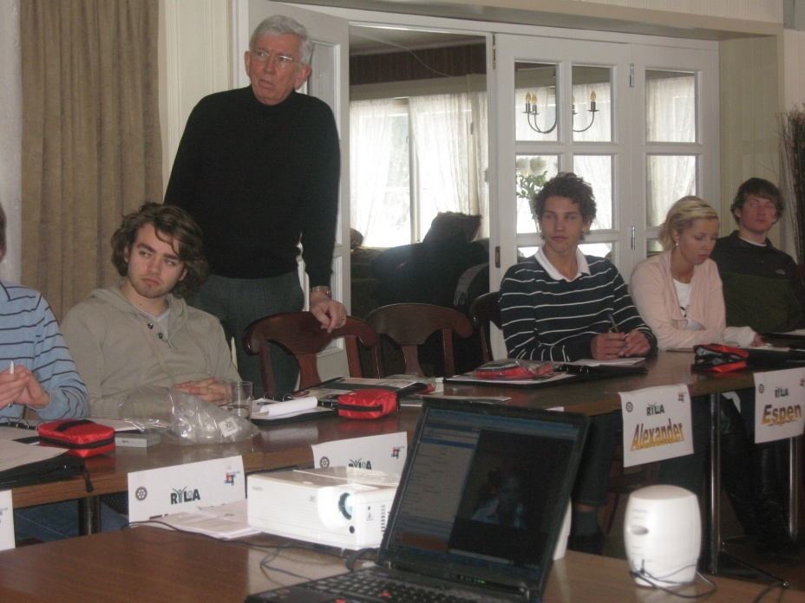
RYLA 2010

Slide 13
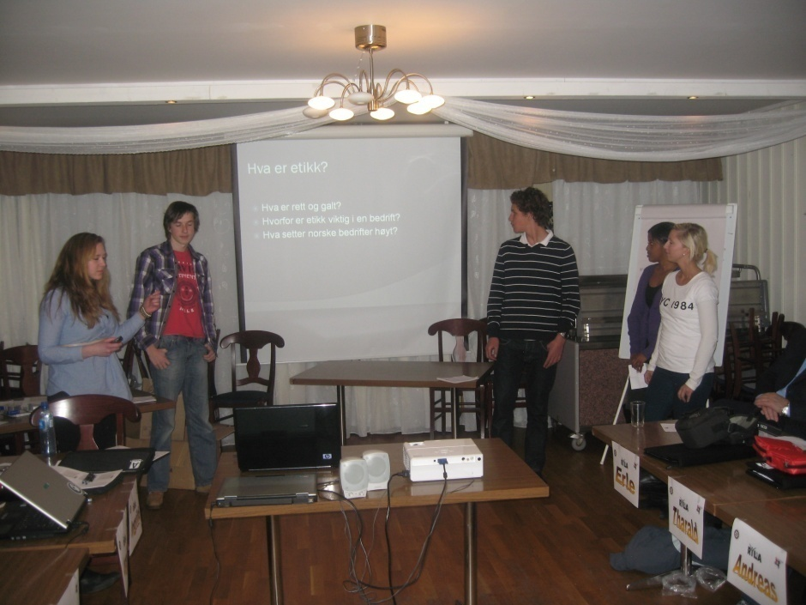
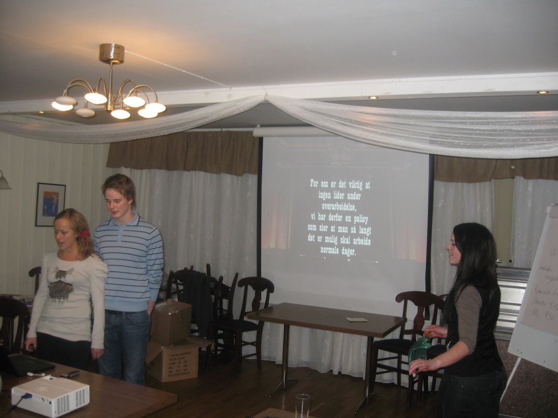
RYLA 2010

Slide 14
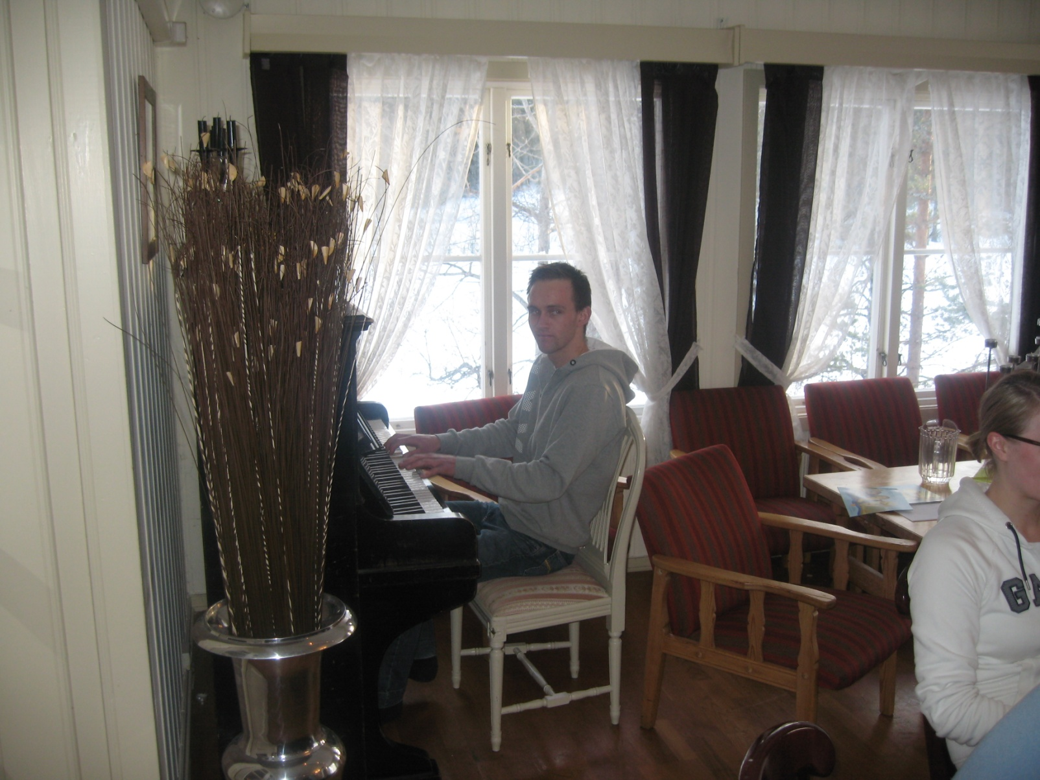
RYLA 2010

Slide 15
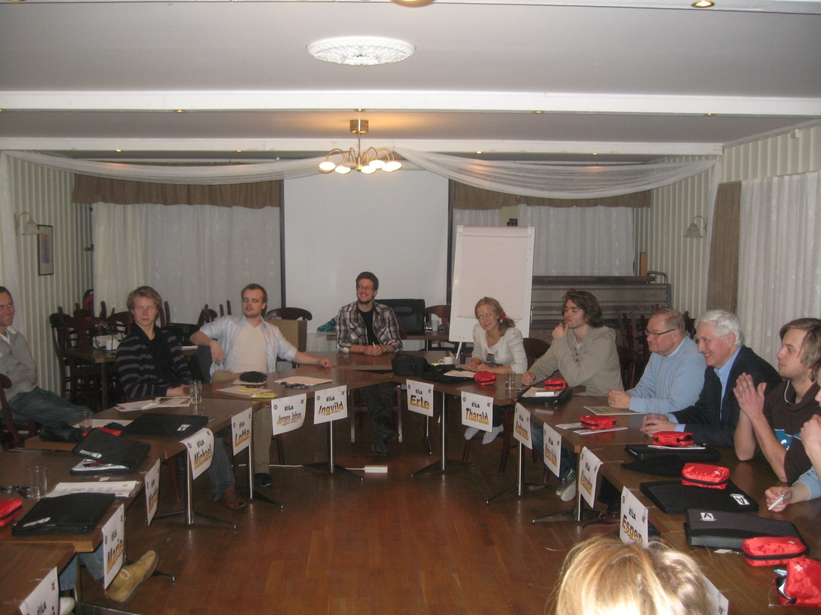
RYLA 2010

Slide 16
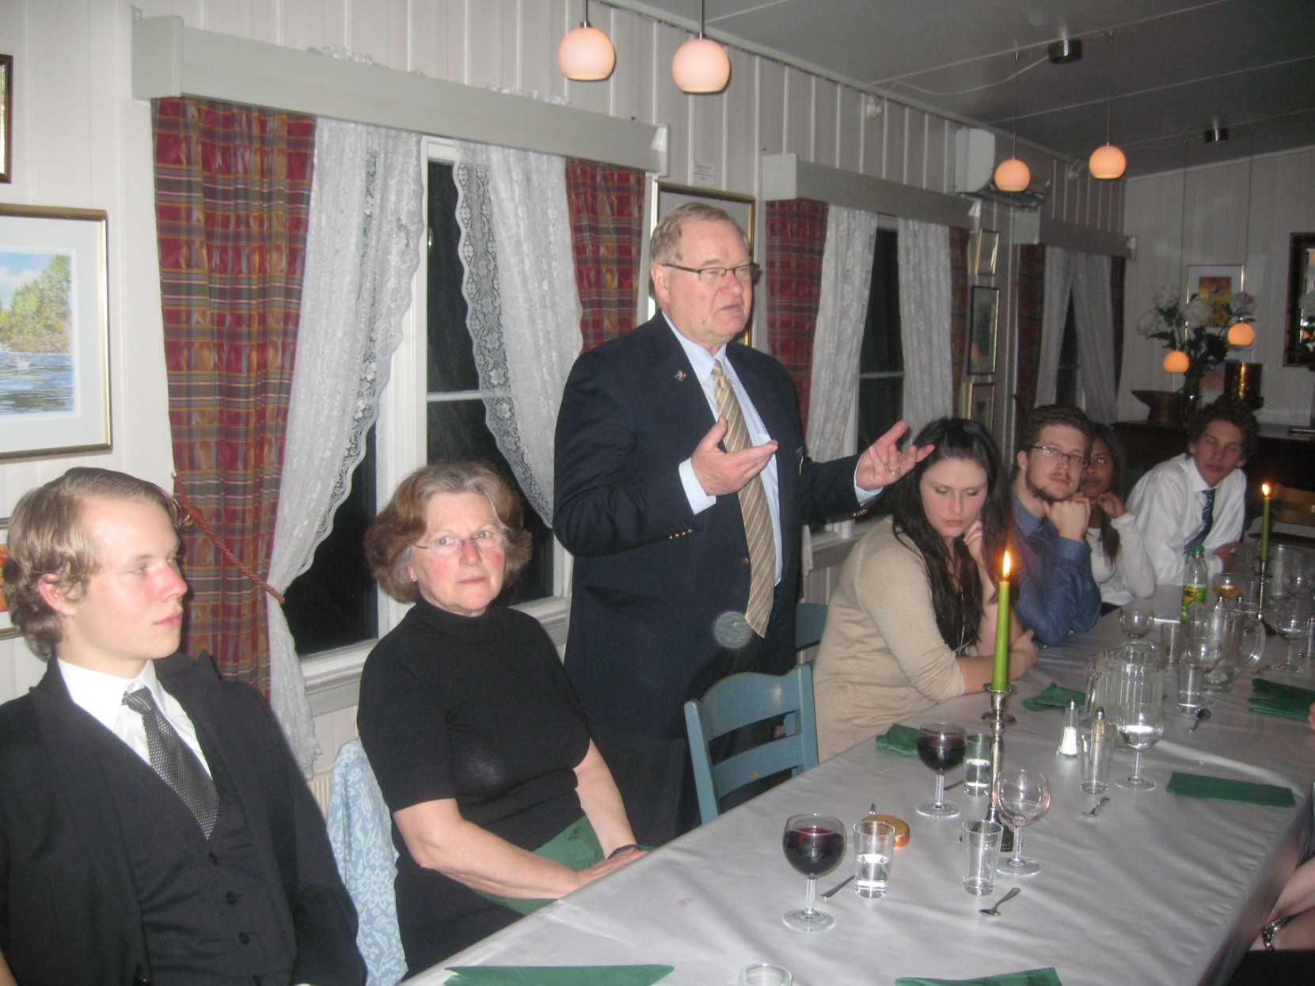
RYLA 2010

Slide 17
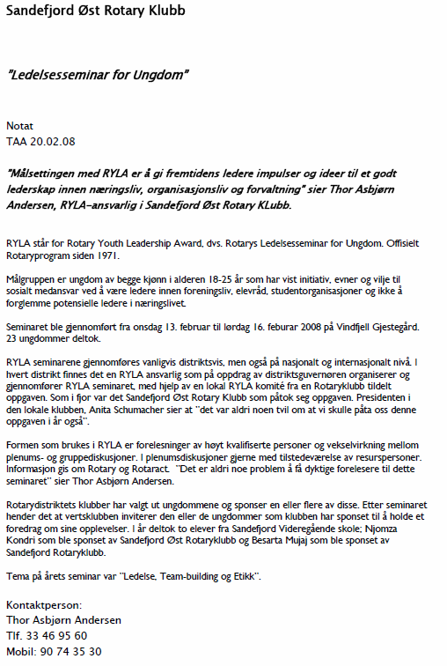
RYLA 2008
Eksempel på pressemelding:

Slide 18
RYLA 2008
Hva kom i avisen:

Slide 19
RYLA’s mål
Rotarys utdanningsprogram for ungdomsledere
viser Rotarys respekt for og engasjement i ungdom.
gir en effektiv utdannelse av utvalgte ungdommer og lovende ledere.
Oppmuntrer ungdom til å lede ungdom.
er en offentlig belønning til unge mennesker som gjør en samfunnsinnsats.

Slide 20
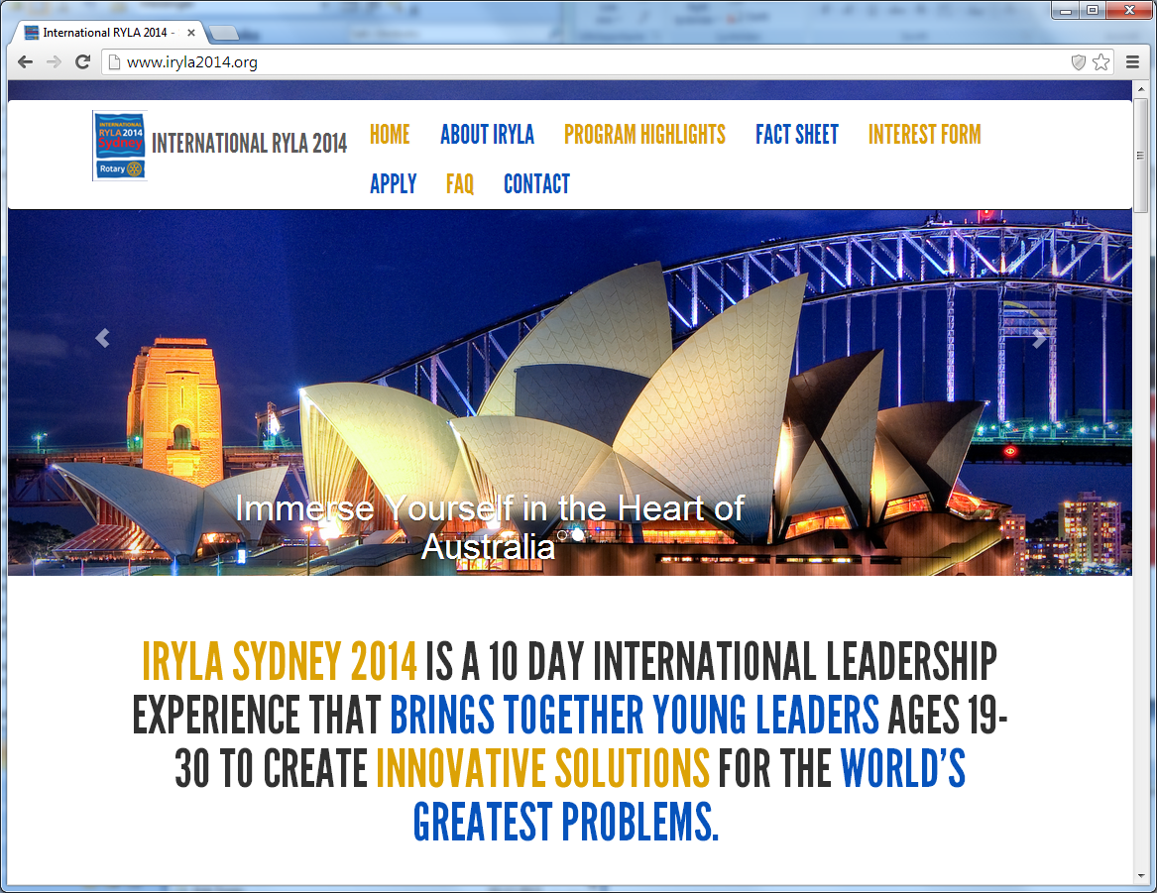
Godt bevart hemmelighet:

Slide 21
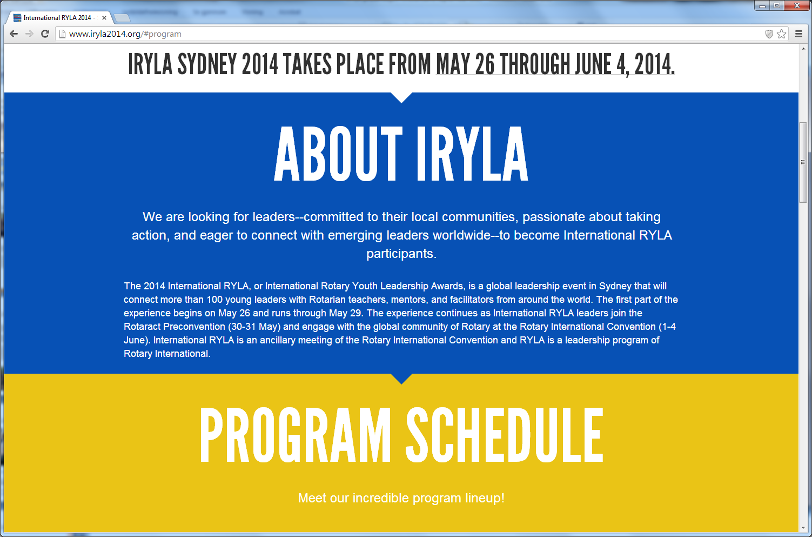
International RYLA

Slide 22
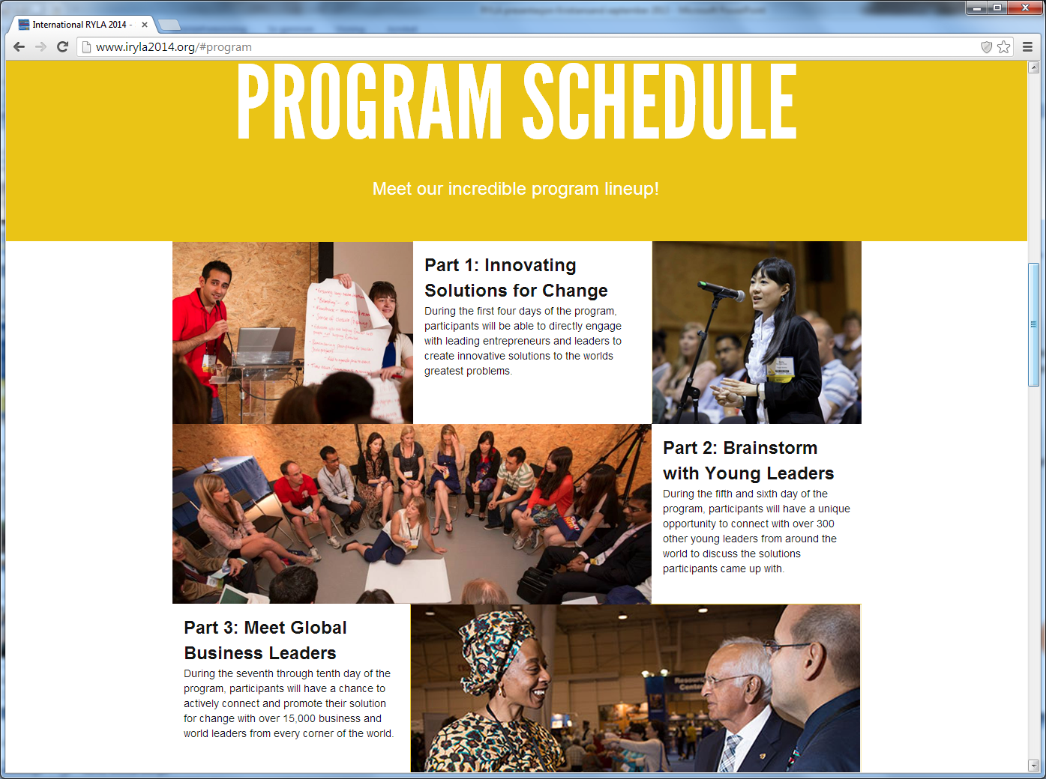
International RYLA

Slide 23
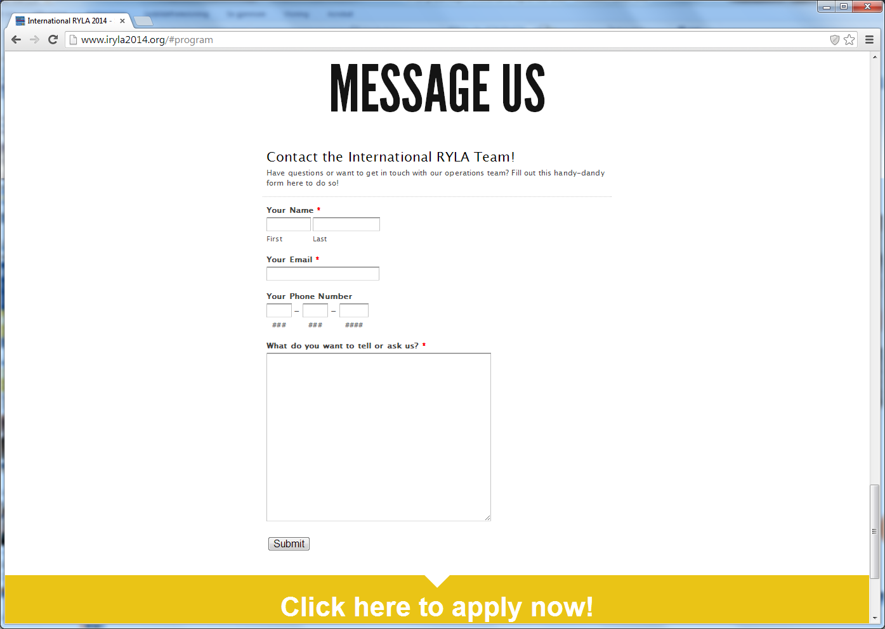
International RYLA (frist 17. januar 2014)

Slide 24

Fra tidligere International RYLA

Slide 25
International RYLA
All Applicants must
Be between the ages of 19-30 at the start of International RYLA (26 May 2014)
Be able to respond promptly to all communications from Rotary, the 2013-14 RYLA Committee, and/or the 2012-14 International RYLA Operations Team
Demonstrate proficiency in English, having the ability to speak and write English as well as to understand spoken and written English, in order to fully participate in this event
Identify a Rotarian Mentor within their community such as a Rotary club president, Rotaract adviser, district RYLA chair, or other Rotarian by 17 January 2014
Secure the endorsement of their district governor by 17 January 2014
Commit to attend the International RYLA event (26-29 May 2013) and the 2014 Rotary International Convention in Sydney, Australia (1-4 June 2014)
Submit all registration costs by 31 March 2014:
  Emerging leaders: US$960 (This fee includes International RYLA, a meal package for 26-29 May, hotel accommodation between 25 May-4 June 2014, and registration for the Rotary International Convention and the Rotaract Preconvention in Sydney, Australia.)
  Young Rotarian leaders: US$1240 (This fee includes International RYLA, a meal package for 26-29 May, hotel accommodation between 25 May-4 June 2014, and registration for the Rotary International Convention and the Rotaract Preconvention in Sydney, Australia. The higher fee is due to higher Rotarian registration costs for the International Convention.)
Successful candidates may be
Young professionals, community leaders, or global citizens without a current Rotary affiliation but with a commitment to our values of vocational expertise, service, and leadership
RYLA participants, Rotaractors, former Rotary program participants, Alumni of The Rotary Foundation, or Rotarians, between the ages of 19-30

Slide 26

International RYLA 2014
Registreringsinformasjon
https://rotary.qualtrics.com/SE/?SID=SV_2fvVG9p1sQRbRul

Slide 27
Konklusjon:
SELVFØLGELIG SKAL VI SETTE AV PENGER I VÅRT BUDSJETT!
MINST ÈN KANDIDAT TIL
NESTE ÅRS RYLA!
og: vurdere om en av disse er en
INTERNATIONAL RYLA - kandidat

